Slide 1
ФАКТОРИНГ ФОРМУЛА ФИНАНСОВОГО УСПЕХА

Slide 2
ПРОМСВЯЗЬБАНК СЕГОДНЯ
Универсальный банк с государственным участием, чья история насчитывает уже более 20 лет
Входит в ТОП-10 крупнейших банков России
Является одним из 11 системно значимых финансовых институтов*
Украина
Казахстан
* Признан Центральным Банком России
Notes:
2
Since its foundation, PSB has developed a network of 43 offices in Moscow and Moscow region (which is geographically our most important market) and has offices in almost all major Russian major cities mainly in the European part of the country, but also in the Far East and Siberia.
As of end of June 2007 we had a total of 150 outlets
This network enables us to operate during business hours in all time zones of the Russian Federation.
As part of our strategy of strengthening our position as a full scale universal bank, we intend to further grow our regional network and increase our presence across Russian regions.
We plan to have [XX] offices and branches by the end of this year, compared to [XX] we have now.
In addition to our domestic presence, we have foreign representative offices in Cyprus, China, India and Ukraine and a network of corresponding banking relations, which allows us to maintain a leading position in clearing services.

Slide 3
НАШИ ПРЕИМУЩЕСТВА
Преимущества факторинга с Промсвязьбанк:
16 лет работы на рынке факторинга
55 филиалов в России – самая развитая региональная сеть
Конкурентная процентная ставка и прозрачные тарифы
Лимит от 1 000 000 руб. на поставщика
Беззалоговое финансирование
Расчеты «день в день»: погашение финансирования в день оплаты покупателем
Ускоренный анализ сделок по упрощенной схеме (7 документов)
Установление лимитов на новых покупателей без истории работы
Дебитор – российская компания с выручкой от 500 млн. рублей в год
Возможность рефинансирования текущей задолженности
Удобное расчетное обслуживание psb-online
Финансирование без предоставления оригиналов (ЭДО)
Персональный менеджер по факторингу
Notes:
3
Since its foundation, PSB has developed a network of 43 offices in Moscow and Moscow region (which is geographically our most important market) and has offices in almost all major Russian major cities mainly in the European part of the country, but also in the Far East and Siberia.
As of end of June 2007 we had a total of 150 outlets
This network enables us to operate during business hours in all time zones of the Russian Federation.
As part of our strategy of strengthening our position as a full scale universal bank, we intend to further grow our regional network and increase our presence across Russian regions.
We plan to have [XX] offices and branches by the end of this year, compared to [XX] we have now.
In addition to our domestic presence, we have foreign representative offices in Cyprus, China, India and Ukraine and a network of corresponding banking relations, which allows us to maintain a leading position in clearing services.

Slide 4
ПОЧЕМУ ФАКТОРНИГ С ПСБ?
Финансовые результаты, руб.
125 МЛРД.
ВЫПЛАЧЕННОЕ ФИНАНСИРОВАНИЯ
БОЛЕЕ
780 КЛИЕНТОВ
БОЛЕЕ
1,4 МЛН. ПОСТАВОК ПРОФИНАНСИРОВАНО
2 000 ДЕБИТОРОВ
17,3%*
ДОЛЯ НА РЫНКЕ ИМПОРТНОГО ФАКТОРИНГА
10%**
ДОЛЯ РЫНКА
* по данным на АФК на 01.07.2018 ** по данным на 30.06.2018
Notes:
4
Since its foundation, PSB has developed a network of 43 offices in Moscow and Moscow region (which is geographically our most important market) and has offices in almost all major Russian major cities mainly in the European part of the country, but also in the Far East and Siberia.
As of end of June 2007 we had a total of 150 outlets
This network enables us to operate during business hours in all time zones of the Russian Federation.
As part of our strategy of strengthening our position as a full scale universal bank, we intend to further grow our regional network and increase our presence across Russian regions.
We plan to have [XX] offices and branches by the end of this year, compared to [XX] we have now.
In addition to our domestic presence, we have foreign representative offices in Cyprus, China, India and Ukraine and a network of corresponding banking relations, which allows us to maintain a leading position in clearing services.

Slide 5
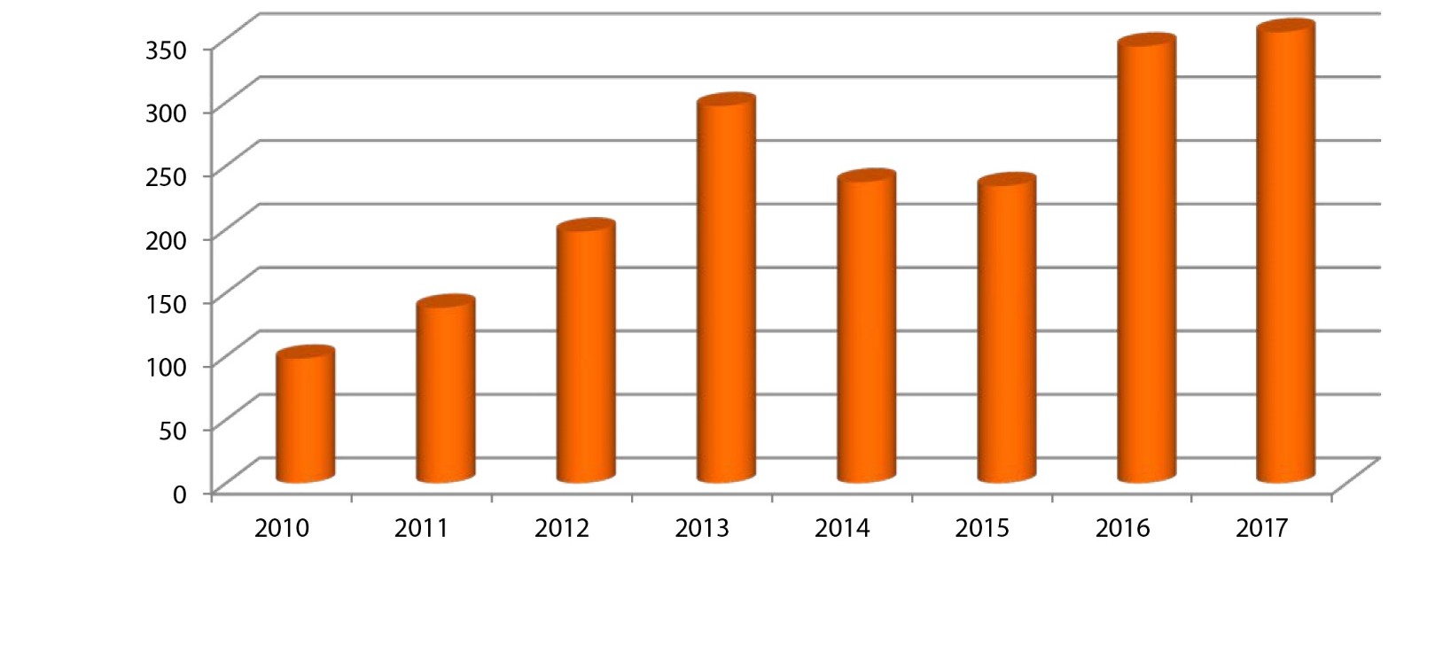
ПОЧЕМУ ФАКТОРНИГ С ПСБ?
ПРОМСВЯЗЬБАНК ВХОДИТ В ТОП-10
ЛИДЕРОВ РЫНКА ФАКТОРИНГА
Notes:
5
Since its foundation, PSB has developed a network of 43 offices in Moscow and Moscow region (which is geographically our most important market) and has offices in almost all major Russian major cities mainly in the European part of the country, but also in the Far East and Siberia.
As of end of June 2007 we had a total of 150 outlets
This network enables us to operate during business hours in all time zones of the Russian Federation.
As part of our strategy of strengthening our position as a full scale universal bank, we intend to further grow our regional network and increase our presence across Russian regions.
We plan to have [XX] offices and branches by the end of this year, compared to [XX] we have now.
In addition to our domestic presence, we have foreign representative offices in Cyprus, China, India and Ukraine and a network of corresponding banking relations, which allows us to maintain a leading position in clearing services.

Slide 6
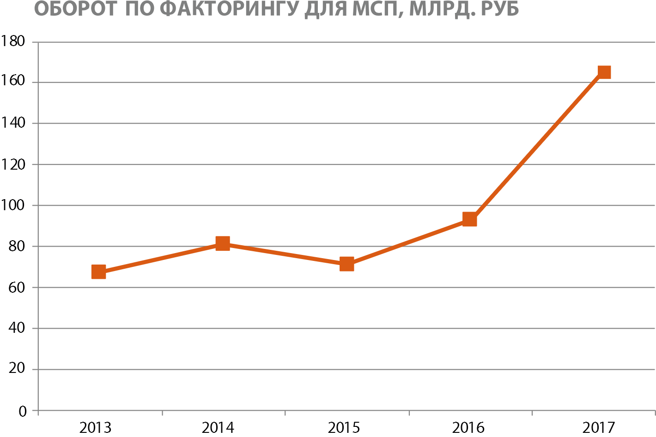
ПОЧЕМУ ФАКТОРНИГ С ПСБ?
ЛИДЕР НА РЫНКЕ ФАКТОРИНГА МСП
Notes:
6
Since its foundation, PSB has developed a network of 43 offices in Moscow and Moscow region (which is geographically our most important market) and has offices in almost all major Russian major cities mainly in the European part of the country, but also in the Far East and Siberia.
As of end of June 2007 we had a total of 150 outlets
This network enables us to operate during business hours in all time zones of the Russian Federation.
As part of our strategy of strengthening our position as a full scale universal bank, we intend to further grow our regional network and increase our presence across Russian regions.
We plan to have [XX] offices and branches by the end of this year, compared to [XX] we have now.
In addition to our domestic presence, we have foreign representative offices in Cyprus, China, India and Ukraine and a network of corresponding banking relations, which allows us to maintain a leading position in clearing services.

Slide 7
РАЗМЕР НЕ ИМЕЕТ ЗНАЧЕНИЯ
ФАКТОРИНГ – РЕШАЮЩИЙ ФАКТОР РАЗВИТИЯ БИЗНЕСА!
ДЕБИТОР - РОССИЙСКАЯ КОМПАНИЯ С ВЫРУЧКОЙ ОТ 500 МЛН. В ГОД
Предварительное решение фактора за один день.
История отношений от 6 месяцев
Быстрая процедура принятия решения
Минимальный пакет документов
Упрощенные требования к покупателям
Бесперебойное финанси-рование
Финансирование до 90% от суммы поставки
С лета 2017 года!
Notes:
7
Since its foundation, PSB has developed a network of 43 offices in Moscow and Moscow region (which is geographically our most important market) and has offices in almost all major Russian major cities mainly in the European part of the country, but also in the Far East and Siberia.
As of end of June 2007 we had a total of 150 outlets
This network enables us to operate during business hours in all time zones of the Russian Federation.
As part of our strategy of strengthening our position as a full scale universal bank, we intend to further grow our regional network and increase our presence across Russian regions.
We plan to have [XX] offices and branches by the end of this year, compared to [XX] we have now.
In addition to our domestic presence, we have foreign representative offices in Cyprus, China, India and Ukraine and a network of corresponding banking relations, which allows us to maintain a leading position in clearing services.

Slide 8
ФАКТОРИНГ VS. КРЕДИТ
ПАРАМЕТРЫ | ФАКТОРИНГ | КРЕДИТ
СРОК ДОГОВОРА | Бессрочный | Фиксированный срок
РАЗМЕР ФИНАНСИРОВАНИЯ | В рамках установленного лимита* | Фиксированная сумма
СРОК ФИНАНСИРОВАНИЯ | В соответствии с договором поставки | Фиксированный срок
ОБЕСПЕЧЕНИЕ | Отсутствует | Часто требуется залог
ПОГАШЕНИЕ | В дату окончания отсрочки платежа по контракту | Фиксированный день
СОСТАВ УСЛУГ | Управление дебиторской задолженностью, покрытие рисков по товарному кредиту | -
ЦЕЛЕВОЕ НАЗНАЧЕНИЕ | - | Контроль за целевым использованием
ВЛИЯНИЕ НА ФИН. ОТЧЕТЫ | Не отражается как кредитное обязательство | Кредитное обязательство
Notes:
8
Since its foundation, PSB has developed a network of 43 offices in Moscow and Moscow region (which is geographically our most important market) and has offices in almost all major Russian major cities mainly in the European part of the country, but also in the Far East and Siberia.
As of end of June 2007 we had a total of 150 outlets
This network enables us to operate during business hours in all time zones of the Russian Federation.
As part of our strategy of strengthening our position as a full scale universal bank, we intend to further grow our regional network and increase our presence across Russian regions.
We plan to have [XX] offices and branches by the end of this year, compared to [XX] we have now.
In addition to our domestic presence, we have foreign representative offices in Cyprus, China, India and Ukraine and a network of corresponding banking relations, which allows us to maintain a leading position in clearing services.

Slide 9
КАК УСТРОЕН ФАКТОРИНГ

Slide 10
ФАКТОРИНГ
КОМПЛЕКС УСЛУГ ДЛЯ ПОСТАВЩИКОВ (ПРОИЗВОДИТЕЛЕЙ) И ПОКУПАЛЕЙ,
РАБОТАЮЩИХ НА УСЛОВИЯХ ОТСРОЧКИ ПЛАТЕЖА, ВКЛЮЧАЕТ В СЕБЯ:
ДЛЯ ПОСТАВЩИКОВ
- финансирование без залога - защита от рисков - административное управление дебиторской задолженностью
ДЛЯ ПОКУПАТЕЛЕЙ
- коммерческий кредит от Банка
предоставление гарантии за Покупателя
ОАО «ПРОМСВЯЗЬБАНК» ПРЕДЛАГАЕТ
РАЗЛИЧНЫЕ ВИДЫ ФАКТОРИНГОВЫХ ПРОДУКТОВ:
ВНУТРЕННИЙ ФАКТОРИНГ
МЕЖДУНАРОДНЫЙ ФАКТОРИНГ
РЕВЕРСИВНЫЙ ФАКТОРИНГ
(ДЛЯ ПОКУПАТЕЛЕЙ)
ФАКТОРИНГ
ДЛЯ ПОСТАВЩИКОВ
ЭКСПОРТНЫЙ
ФАКТОРИНГ
ИМПОРТНЫЙ
ФАКТОРИНГ
С РЕГРЕССОМ
ОТКРЫТЫЙ
ЗАКРЫТЫЙ
С РЕГРЕССОМ
БЕЗ РЕГРЕССА
… и другие индивидуальные
решения для Вашего бизнеса
С РЕГРЕССОМ
БЕЗ РЕГРЕССА
С РЕГРЕССОМ
БЕЗ РЕГРЕССА

Slide 11
СТОИМОСТЬ ФАКТОРИНГА
УПРАВЛЕНИЕ ДЕБИТОРСКОЙ ЗАДОЛЖЕННОСТЬЮ – дополнительный инструмент снижения риска невозврата задолженности, включающий в себя:
Проверку надежности и кредитной истории дебиторов
Мониторинг платежной дисциплины дебиторов
Сбор дебиторской задолженности
КОМИССИЯ ЗА АДМИНИСТРАТИВНОЕ УПРАВЛЕНИЕ ДЕБИТОРСКОЙ ЗАДОЛЖЕННОСТЬЮ*
1.
Фиксированная комиссия от 0 до 60 руб. за учет
и обработку одной счет-фактуры
2.
КОМИССИЯ ЗА ФАКТОРИНГОВОЕ ОБСЛУЖИВАНИЕ**
% от поставки за каждый день финансирования. Зависит от группы риска поставщика и дебитора
3.
КОМИССИЯ ЗА ПРЕДОСТАВЛЕНИЕ ДЕНЕЖНЫХ РЕСУРСОВ
% от суммы финансирования за каждый день финансирования. Зависит от срока финансирования
* Тариф от 0 руб. за обработку счет-фактуры – при условии ЮЗЭДО
** Скидка при расчетах через ПСБ
Notes:
11
Since its foundation, PSB has developed a network of 43 offices in Moscow and Moscow region (which is geographically our most important market) and has offices in almost all major Russian major cities mainly in the European part of the country, but also in the Far East and Siberia.
As of end of June 2007 we had a total of 150 outlets
This network enables us to operate during business hours in all time zones of the Russian Federation.
As part of our strategy of strengthening our position as a full scale universal bank, we intend to further grow our regional network and increase our presence across Russian regions.
We plan to have [XX] offices and branches by the end of this year, compared to [XX] we have now.
In addition to our domestic presence, we have foreign representative offices in Cyprus, China, India and Ukraine and a network of corresponding banking relations, which allows us to maintain a leading position in clearing services.

Slide 12
ФАКТОРИНГ С РЕГРЕССОМ
ПОСТАВЩИК НЕСЕТ ОТВЕТСТВЕННОСТЬ ЗА ИСПОЛНЕНИЕ ПОКУПАТЕЛЕМ СВОИХ ОБЯЗАТЕЛЬСТВ ПО ОПЛАТЕ ПОСТАВОК
Финансирование до 95% от суммы поставки
отсутствие кассовых разрывов у Поставщика
Конкурентные преимущества
предоставление льготных условий от Поставщика
Оперативное реагирование на изменение спроса
возможность резкого увеличения объема закупок
Долгосрочное сотрудничество
заключение бессрочного Договора факторинга
Финансирование без залога
экономия на расходах по оформлению залога

Slide 13
ФАКТОРИНГ С РЕГРЕССОМ
Поставка товара на условиях отсрочки платежа
Поставщик
1
Покупатели
5
2
Выплата остатка
полученных от покупателей
денежных
средств за вычетом
суммы финансирования
и комиссий
3
4
Уступка банку денежных требований по поставке
Финансирование поставщика до 99% от суммы поставки
Оплата за поставленный товар
6

Slide 14
НАШИ КРУПНЕЙШИЕ ДЕБИТОРЫ – ВАШИ БУДУЩИЕ ПОКУПАТЕЛИ
Минимальная ставка комиссий
Финансирование до 90% от суммы поставки
Предварительное решение за 1 час
Партнерские отношения с торговыми сетями
Закрытый факторинг (уникальная услуга)
Авансовые лимиты (с первой поставки)
Минимальный пакет документов
БОЛЕЕ 60 ТОРГОВЫХ СЕТЕЙ и
БОЛЕЕ 130 КОМПАНИЙ ТОП-600
Notes:
14
Since its foundation, PSB has developed a network of 43 offices in Moscow and Moscow region (which is geographically our most important market) and has offices in almost all major Russian major cities mainly in the European part of the country, but also in the Far East and Siberia.
As of end of June 2007 we had a total of 150 outlets
This network enables us to operate during business hours in all time zones of the Russian Federation.
As part of our strategy of strengthening our position as a full scale universal bank, we intend to further grow our regional network and increase our presence across Russian regions.
We plan to have [XX] offices and branches by the end of this year, compared to [XX] we have now.
In addition to our domestic presence, we have foreign representative offices in Cyprus, China, India and Ukraine and a network of corresponding banking relations, which allows us to maintain a leading position in clearing services.

Slide 15
КОНТАКТЫ
ПО ВОПРОСАМ ФАКТОРИНГА В ПРОМСВЯЗЬБАНКЕ ВЫ МОЖЕТЕ ОБРАЩАТЬСЯ ПО СЛЕДУЮЩИМ ТЕЛЕФОНАМ
Клиенты среднего бизнеса: (4912) 95-60-29
Клиенты малого бизнеса: (4912) 95-60-20, (4912) 95-60-43
МЫ НАХОДИМСЯ ПО АДРЕСУ: г. Рязань, ул. Ленина, д. 9 (ТЦ Аркада)
Notes:
15
Since its foundation, PSB has developed a network of 43 offices in Moscow and Moscow region (which is geographically our most important market) and has offices in almost all major Russian major cities mainly in the European part of the country, but also in the Far East and Siberia.
As of end of June 2007 we had a total of 150 outlets
This network enables us to operate during business hours in all time zones of the Russian Federation.
As part of our strategy of strengthening our position as a full scale universal bank, we intend to further grow our regional network and increase our presence across Russian regions.
We plan to have [XX] offices and branches by the end of this year, compared to [XX] we have now.
In addition to our domestic presence, we have foreign representative offices in Cyprus, China, India and Ukraine and a network of corresponding banking relations, which allows us to maintain a leading position in clearing services.

